Slide 1

RE3: Finding Refinement Relations with Relational Mapping Abstraction
Northwestern University, USA
You Li*, Guannan Zhao*, Yunqi He, and Hai Zhou
*Equal Contribution
Notes:
In this talk, we will discuss a new approach that generates refinement relations between two hardware designs. I am You Li and this work is conducted in collaboration with Guannan Zhao and advised by professor Hai Zhou.

Slide 2
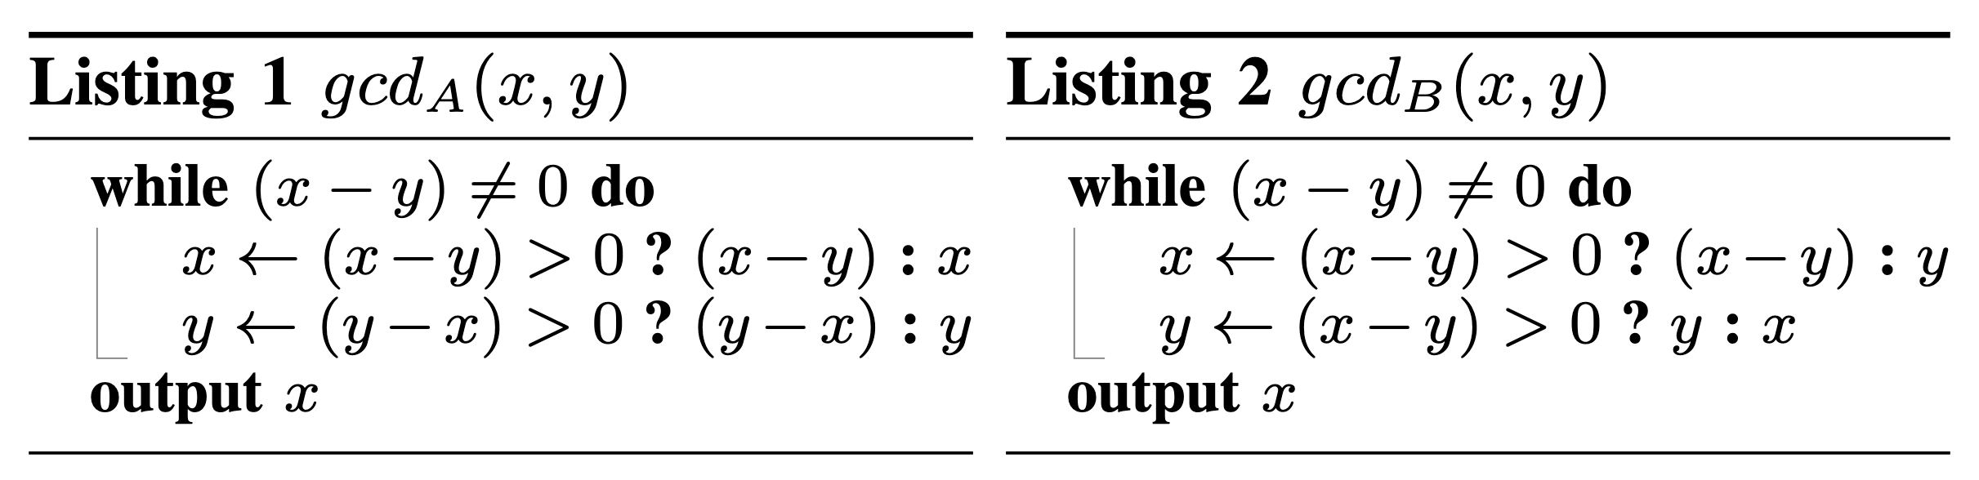
Refinement Checking
Refinement checking is a formal sequential equivalence checking approach.
It verifies whether a low-level implementation complies with a high-level specification.
E.g., behavioral model vs. RTL, RTL vs. derived RTL.
A refinement relation is an equivalence relation that specifies how the states of the impl and the states of the spec are related.
gcd_{A}
(5,3)
(2,3)
(2,1)
(1,1)
gcd_{B}
(5,3)
(2,3)
(3,2)
(1,2)
(2,1)
(1,1)
Notes:
Refinement checking is a formal sequential equivalence checking approach that verifies whether a low-level implementation complies with a high-level specification. In this setting, the two models can be different in timing and their registers can have different functionalities. Examples of refinement checking includes verifying whether an RTL design complies with a high-level behavioral model, or verifying whether a sequentially optimized RTL complies with its previous version.
We use the Euclid’s algorithm as a running example. gcd_A is a behavioral model that allocates two subtractors simultaneously so it can compute both x – y and y – x in the same clock cycle. gcd_B is an RTL implementation that allocates only one subtractor to compute x – y. If x is less than y, it needs to swap x and y, and this takes an additional clock cycle. Suppose the initial values of x and y are 5 and 3. It takes gcd_A 3 clock cycles and gcd_B 5 clock cycles to finish the computation. A refinement checker should regard gcd_A and gcd_B as equivalent because they always output the same results for any initial values.
A refinement relation is an equivalence relation that specifies how the states of the implementation and the the states of the specification are associated.

Slide 3
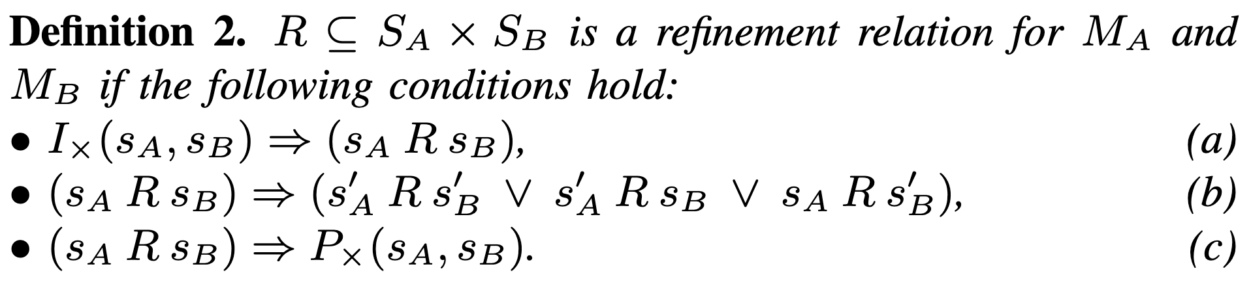
Refinement Relation
R is a valid refinement relation if conditions (a) – (c) hold.
A refinement relation partitions the state space of the product machine into disjoint equivalent classes.
gcd_{A}
(5,3)
(2,3)
(2,1)
(1,1)
gcd_{B}
(5,3)
(2,3)
(3,2)
(1,2)
(2,1)
(1,1)
Notes:
A refinement relation R is defined on the product state space of the two models. A valid refinement relation should satisfy all the conditions (a) through (c).
The following expression R is a valid refinement relation. It states that either x of A equals x of B and y of A equals y of B, or x of A equals y of B and x of B equals y of A. In other words, either the register values of A and B are the same, or they will become the same after swapping the x and y values of B.
We can validate that R is indeed a refinement relation. Condition (b) states that if two states are related by R, one of their successor states must also be related by R. It could be either of the following three cases: both A and B move forward, only A moves forward, and only B moves forward. In the gcd example, the states (2, 3) and (2, 3) are related by R. After that, we let only B moves forward, and the next pair of states (2, 3) and (3, 2) are still related by R.
We can also observe that a refinement relation partitions the state space of the two models into disjoint equivalent classes. In this example, the pairs of states with the same color are within the same equivalent class.

Slide 4
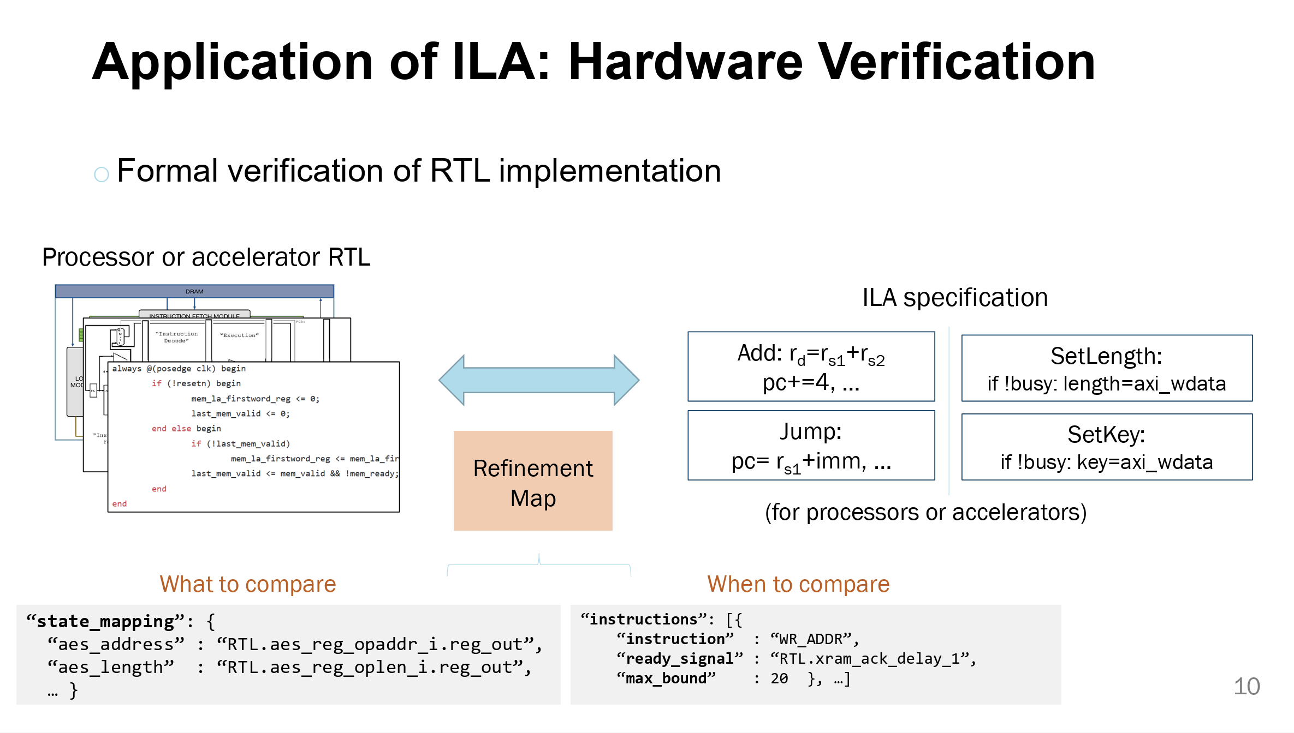
Refinement Relation: Applications
Refinement relation has various applications in EDA and other fields.
Regression verification & Root cause analysis
Design synthesis & Design space exploration
The “refinement mapping” in Instruction-Level Abstraction (ILA)
Generating refinement relations automatically can save human efforts and avoid errors.
Notes:
Refinement relation has a wide range of applications in electronic design automation and other related fields.
In regression verification, the verification engineer can maintain a refinement relation between two consecutive versions of the design to ensure that the design transformations are conducted correctly. In root cause analysis, a refinement relation can help to detect errors associated with a particular register or a particular location in the control flow. In design synthesis, a refinement relation are utilized to produce an implementation from a reference model.
In high-level to RTL verification, refinement relation is an essential component to bridge the gap between different abstraction levels.
Manually constructing a refinement relation requires both domain knowledge and expertise in formal verification. It is very difficult for a human engineer to write a correct refinement relation for complex designs after significant design transformations. Our objective is to develop an automatic approach that can generate a refinement relation between two models.

Slide 5
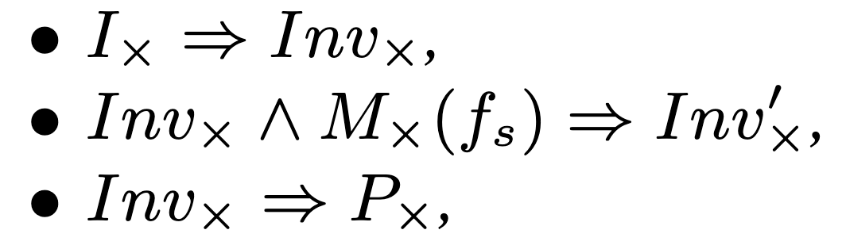
Equivalence Checking as Self-composition
We reduce the problem of generating refinement relation to a) generating a scheduling function f_{s}, and b) finding an inductive invariant Inv× given f_{s}.
A product machine M× is a parallel composition of models A and B.
A scheduling function f_{s} maps every pair of states (s_{A}, s_{B}) to {A, B, A ∪ B}.
If there exists an inductive invariant Inv× such that
then Inv× is a valid refinement relation R.
gcd_{A}
(5,3)
(2,3)
(2,1)
(1,1)
gcd_{B}
(5,3)
(2,3)
(3,2)
(1,2)
(2,1)
(1,1)
Notes:
The problem of finding a refinement relation can be reduced to a model checking problem. Consider a product machine M which is a parallel composition of models A and B. Let fs be a scheduling function that determines which models between A and B should move forward for every state of the product machine. If there exists an inductive invariant INV and a scheduling function fs for the product machine, then INV itself is a valid refinement relation.
For our gcd example, consider the following scheduling function: if x of B is greater than or equal to y of B, then both A and B move forward. Otherwise, only B moves forward. This scheduling function gives rise to an inductive invariant, which is the refinement relation we have seen in the previous slide. We can use an unbounded model checker to find such an inductive invariant.

Slide 6
Relational Mapping Abstraction
We observe that memory elements (latches) are the first-class citizens in an equivalence checking problem.
We propose relational mapping abstraction can capture the conditional latch mapping between two designs.
The abstract domain can be represented as the following:
The variables of model A can only appear in pred_{A} and the left-hand side of mapping
The variables of model B can only appear in pred_{B} and the right-hand side of mapping
Spurious counterexamples can be eliminated by introducing new predicates or new pairs of mappings.
Notes:
Memory elements, or latches, play an essential role in equivalence checking. The equivalence relation can be expressed as a conditional latch mapping between the two designs. We leverage this prior knowledge to design the abstraction domain for equivalence checking. Each abstract state consists of three fields. The first field is a set of predicates on model A, the second field is a set of predicates on model B, and the last field is a set of one-to-one latch mappings between the two designs.
A spurious counterexample can be eliminated by adding new predicates to the first two fields, or adding new equivalent pairs to the last field. In practice, we use interpolation to find new predicates and use syntax-guided abstraction refinement to find new equivalent pairs. Then we choose the most concise field among the three to settle down the refinement.

Slide 7
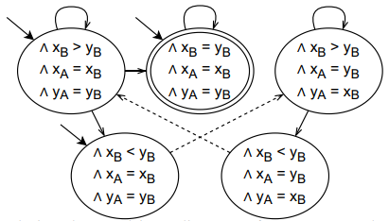
Relational Transition Diagram
Given a valid scheduling function and a valid relational mapping abstraction domain, we can plot a relational transition diagram.
Below shows the relational transition diagram for the GCD example given the scheduling function:
Notes:
A relational transition diagram can be uniquely determined by a valid scheduling function and a valid relational mapping abstraction domain. The diagram below shows a relational transition diagram for the GCD example. The corresponding scheduling function states that if the variable x of B is greater than or equal to the variable y of B, a synchronized transition should be taken, that both A and B should move forward. Otherwise, a stuttering transition should be taken, that only B should move forward. Every node in the diagram represents an abstract state following the relational mapping abstraction. A solid arrow represents a synchronous transition and a dashed arrow represents a stuttering transition.

Slide 8
Refinement Relation Synthesis Algorithm
Navigates the search process toward a compact and comprehensible refinement relation.
Tasks:
Find a general scheduling function f_{s} that gives rise to a compact refinement relation.
Find a suitable abstraction domain α that leads to a comprehensible refinement relation.
Find an inductive invariant Inv× on the product machine M×.
Scheduling function:
Starting from an unconstrained version, iteratively adding new constraints.
Abstraction domain:
Refine abstraction domain only when it is impossible to refine the scheduling function.
Invariant synthesis:
Use reversed IC3 model checking algorithm.
Notes:
As we discussed before, if we already know the scheduling function and the abstract domain, the problem of finding a refinement relation is reduced to finding an inductive invariant on the product machine of A and B. So we leverage the IC3 unbounded model checking algorithm to find such an inductive invariant. In this problem, we have three main objectives. First, we need to search for an ideal scheduling function that gives rise to a compact refinement relation. Second, we need to construct an abstraction domain that leads to a comprehensible refinement relation. Finally, we need to synthesize an inductive invariant given the scheduling function and the abstraction domain.

Slide 9
Refinement Relation Synthesis Algorithm
α ← ∅ % initialize abstract domain
While true do
Fs ← ∅ % reset scheduling constraints
While true do
cex ← model_checking (M×, Fs, α)
If not cex
return refinement relation
Else
Fs ← refine (Fs, cex)
If is_invalid (Fs)
break
α ← refine (α, cex)
Notes:
This slide shows the pseudocode of our algorithm. Here alpha represents the abstraction domain and Fs represents the scheduling constraints. In every iteration of the outer loop, the algorithm resets Fs to no constraints, because a more general scheduling function is likely to produce a more concise refinement relation. In every iteration of the inner loop, the algorithm calls a customized IC3 model checker to see whether there exists a counterexample. If not, it returns the refinement relation which is constructed from the inductive invariant, the scheduling function, and the abstraction domain. Otherwise, it adds new scheduling constraints to eliminate the counterexample. If it is no longer feasible to add a valid scheduling constraint, it will instead exit to the outer loop and refine the abstraction domain. In this way, the algorithm steers the searching process toward a more concise refinement relation, and reduces the overall complexity by applying abstraction refinement only when necessary.

Slide 10
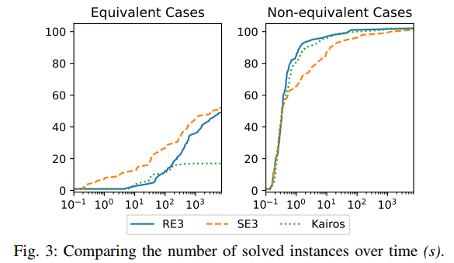
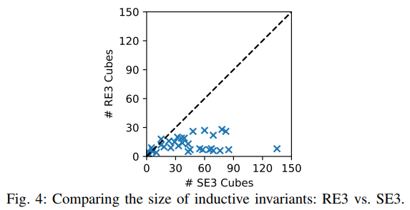
Experimental Results
The execution time of the proposed algorithm is similar to baseline equivalence checking algorithms.
In other words, the capability of synthesizing concise refinement relations is “free”.
Achieves 69% reduction on the size of inductive invariant.
Notes:
The execution time of the proposed algorithm is similar to the state-of-the-art non-cycle-accurate sequential equivalence checking algorithms. In other words, it can synthesize a refinement relation with almost no extra cost.
The right figure compares the compactness of the generated inductive invariant. The proposed algorithm achieves a 69 percent reduction in size over the baseline algorithm on average.

Slide 11
Error Detection and Correction
LLM-assisted RTL generation:
LLMs are susceptible to hallucination; they can generate results that contain subtle errors
Simulation tools cannot detect all errors
LLMs cannot easily interpret error traces
RTL generation is an iterative refinement process
LLM optimizes the performance or incorporate new features in every iteration
Use refinement relation for error detection and correction on RTLLM benchmarks
Maintain a refinement relation between consecutive versions
Traverse edges of of the relational transition diagram to find violations
Notes:
Large language models are capable of generating RTL designs from design specifications. However, they have a main drawback which is their tendency to hallucinate. They can generate results that contains subtle factual or logic errors.
Simulation tools cannot guarantee to find all such errors.
We observe that RTL generation is an iterative process. In every iteration, the LLM either optimize the performance or introduce new features to the design.
As a case study, we test whether refinement relation can facilitate error detection and correction on the RTLLM benchmark suite. Our tool maintain a refinement relation between every two consecutive versions of the design. Given a new version from the LLM, our tool traverses all edges of the relational transition diagram to find potential violations. If a violation is confirmed to be valid, our tool prompts the LLM with the control flow information and register information extracted from the diagram.

Slide 12
Thank you!
Notes:
That is all for my presentation and thank you for your attention!

