Slide 1


LLA: Enhancing Security and Privacy for Generative Models
with Logic-Locked Accelerators
You Li*, Guannan Zhao*, Yuhao Ju, Yunqi He, Jie Gu and Hai Zhou
If you have any questions, please contact us at
acl2022@underline.io
We are happy to help!
*Equal Contribution
Notes:
Hi, in this talk, we will discuss how to leverage the synergy of software and hardware to re-establish the security foundation of generative AI models.
I am professor hai zhou, and this work is led by my students, doctor You Li and doctor Guannan Zhao.

Slide 2
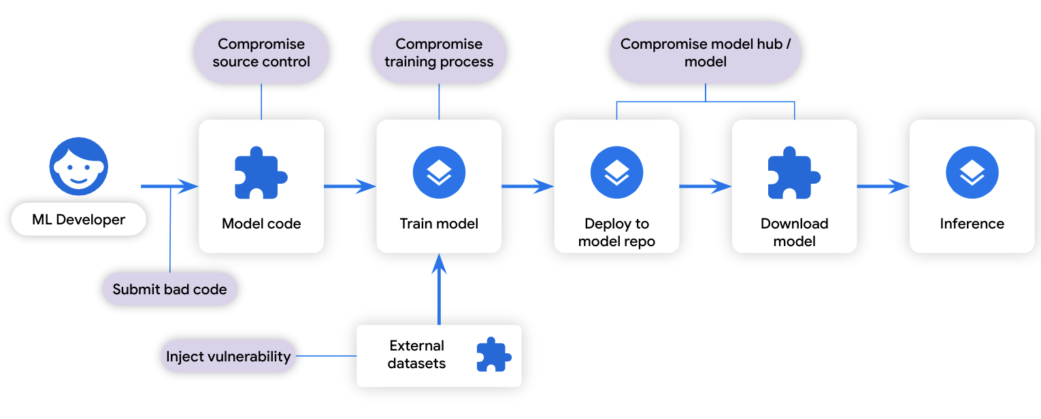
Supply Chain Security of Generative Models
New business models have emerged for generative AI:
  Inference-as-a-service: models are hosted on the cloud and accessed through APIs
  Self-hosting: models are deployed within an organization
  Model parameters are directly exposed to participants within the supply chain
Unauthorized access to proprietary models can cause financial loss to IP owners
Unrestricted access to model parameters can pose serious security risks:
  Adversarial prompts
  Backdoor attacks
Notes:
GenAI is a revolutionary technology, but training a GenAI model requires massive data, substantial computational resources, and high expertise. As a result, new business models have emerged to allow clients with limited resources to access GenAI capabilities. Inference-as-a-service means that models are hosted on the cloud and accessed through APIs. Self-hosting allows organizations to deploy models internally and thus protect their confidential information.
In both scenarios, model parameters are exposed to various participants within the model supply chain, including cloud service providers, network service providers, and end-users. Unauthorized distribution of proprietary models can cause significant financial loss to the IP owners. Moreover, unrestricted access to model parameters can poses serious security risks. For example, adversarial prompts can cause the generation of harmful and misleading content, while backdoor attacks allow attackers to manipulate the generated content through malicious triggers.

Slide 3
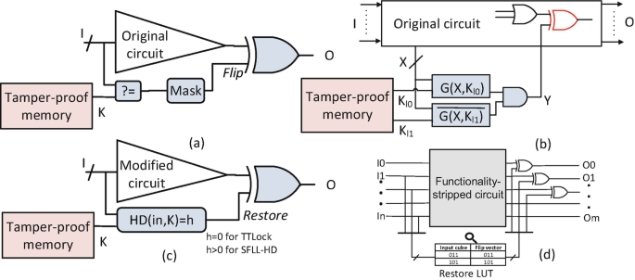
From Logic Locking to Model Locking
Logic locking uses binary key bits to protect logic circuits
  It inserts protection units to the circuit netlist
  Each unit is controlled by binary key bits
  The secret key is stored on chip in a tamper-proof module
  Without knowing the correct key, an adversary cannot restore the original functionality of the circuit
Model locking extends logic locking to protect AI models
  Network of neurons vs. network of logic gates
Notes:
Logic locking is a prominent approach to protect the intellectual property of integrated circuits. It embeds key-controlled protection units into a circuit netlist, which is essentially a network of logic gates. The secret key is stored on-chip in a tamper-proof module. As a result, an adversary cannot recover the original functionality of the circuit without knowing the correct key.
This methodology can be extended to protect the intellectual property of AI models. In this setting, the neural network is regarded as a network of neurons. But an AI model is not a hardware. How is it possible to implement model locking in reality?

Slide 4
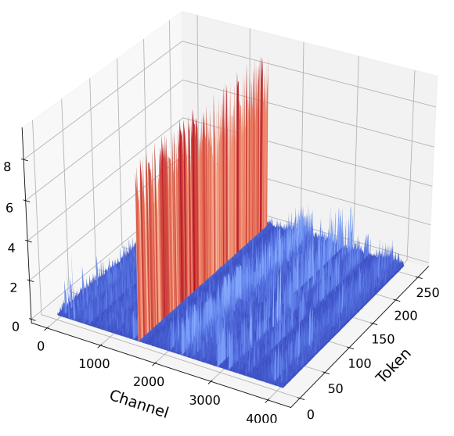
Main Challenges
The gap between software and hardware:
  Model Locking is a software concept, whereas the secret key is stored on hardware
The redundancy of model parameters:
  Most neurons are inactive during inference
  Changing random parameters has minimal impact on model performance
The existence of outliers (the abnormally large weights and features):
  Outliers are disproportionately important to model performance
  An adversary can infer key values through outlier features
Notes:
We encountered several critical challenges when applying logic locking to generative models. First, model locking is a software concept, whereas the secret key is stored on hardware. It is unclear how to bridge this gap at a reasonable cost. Second, generative models have billions of parameters, and these parameters are highly redundant. Removing 25% of layers in Llama2-13B results in only a slight performance drop. Third, generative models contain outliers, which are the abnormally large weights and features. Suppressing a single weight outlier can have a more significant impact than pruning hundreds of thousands of normal weights. An adversary can infer key values by observing their effects on outlier features.

Slide 5
Threat Model
We consider a general and realistic threat model. The adversary can:
  Access the model architecture and all the parameters
  Query the model for polynomial times
  Obtain a small portion of the training dataset (~5%)
The adversary aims infer the correct key or recover the original functionality
Notes:
We assume a general and realistic threat model. The adversary can be any parties within the model supply chain, including the cloud service provider, the network service provider, or the end user. It can obtain the model architecture and all the parameters, query the model through cloud API or an activated hardware, and obtain a small portion of the training dataset. The goal of the adversary is to find the correct key or recover the functionality of the original model.

Slide 6
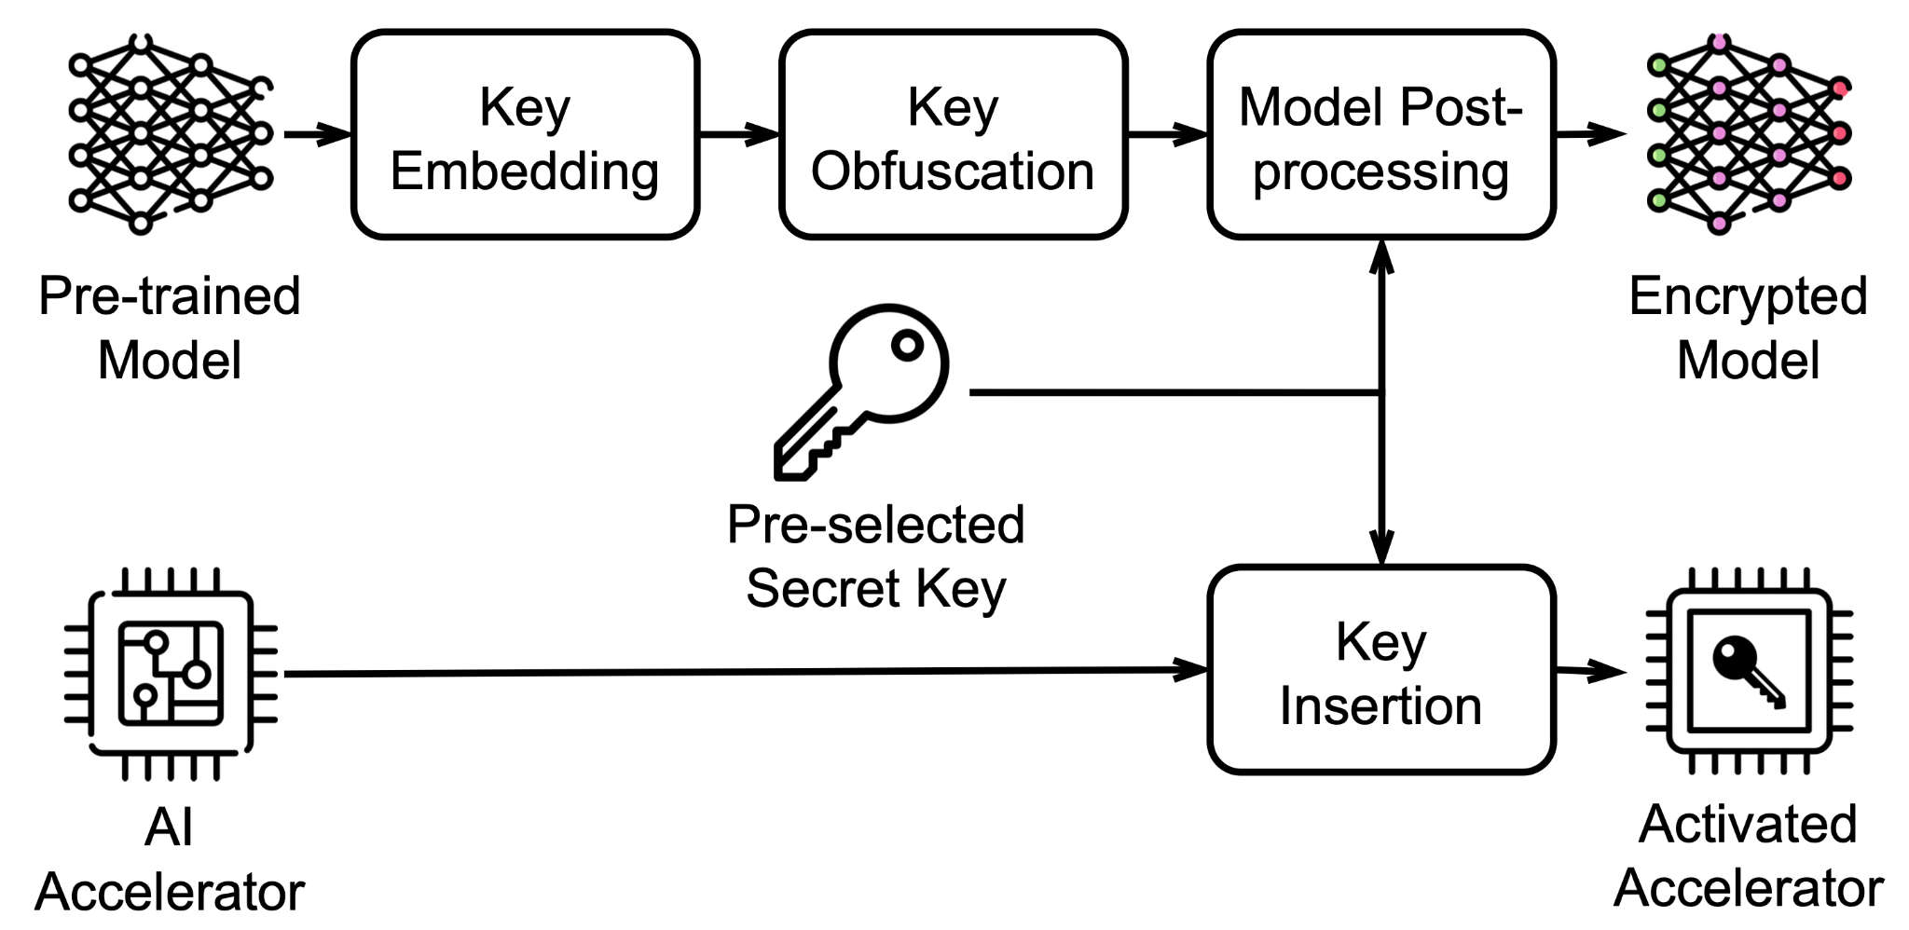
Overall Workflow
LLA is an inference-time model locking framework
A model functions correctly only when the correct key is embedded in the hardware
  An encrypted model can be sent to the user through a public channel
  A piece of accelerator hardware with pre-installed secret key serves as a license to access the service provided by the model IP owner
Notes:
The proposed LLA, or logic-locked accelerator framework can be applied to any given generative model and does not require additional training. LLA leverages the synergy of software and hardware to achieve robustness and efficiency at the same time. At the software level, it associate key bits with selected protection neurons, employ key obfuscation to enhance robustness, and apply model post-processing so that a correct key can resume the original functionality. At the hardware level, it attaches a lightweight locking unit to the systolic array of an accelerator, so that all operations can be conducted on the fly with minimum overhead.
Our design ensures that the model will function correctly only when a correct key is embedded in the hardware. Therefore, an encrypted model can be sent to the user through a public channel, and a piece of hardware with a pre-installed secret key serves as a license to access the service of the model provider.

Slide 7

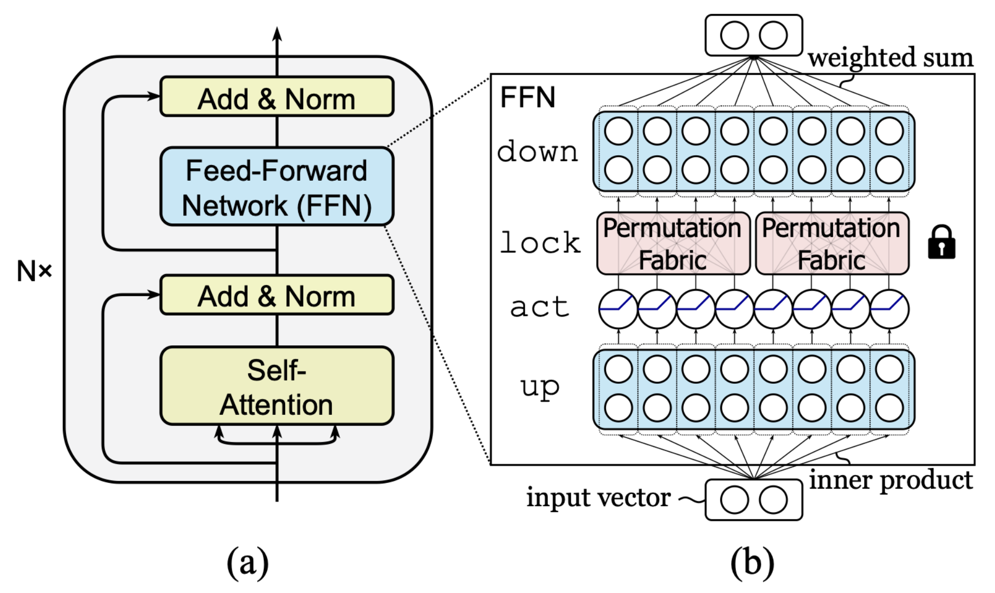
Locking Mechanism – Overview
The locking process is a sequence of function-preserving orthogonal transformations ( ):
All matrices within the parentheses can be merged with W^{up} and W^{down}
LLA selects the feed-forward network (FFN) of a single transformer layer to place key bits:
  Weight outliers mainly concentrate in W^{down}
  All key bits are interdependent
Notes:
Next, we will introduce the locking mechanism of LLA from the software perspective. The first step is to identify the protection neurons. The locking procedure consists of a sequence of function-preserving orthogonal transformations, in which every transformation matrix is cancelled by its transpose, so the final output remains the same. All the matrices within the same pair of parentheses can be merged together to form the new up and down matrices. LLA selects the feed-forward module of a single transformer layer to place key bits. In such a way, it can always trigger the weight outliers within the down layer, and ensure that all key bits are correlated with each other.

Slide 8

Locking Mechanism – Protecting Weight Outliers
is the permutation matrix, where
  P_{j} swaps the j-th protection neuron with the j-th neuron in the FFN module
  It repositions protected neurons to the front of feature dimension
Neurons which can trigger the weights outlier are selected as protection neurons
  Use random simulation for identification
Notes:
The first pair of transformation matrices are the permutation matrices, P and P-transpose. The P matrix reorders the neurons within an FFN module, so that all the protection neurons are repositioned to the front of the feature dimension. Those neurons which can trigger the weight outliers are selected as the protection neurons. In practice, we use random simulation to detect the neurons that can produce large feature magnitudes.

Slide 9
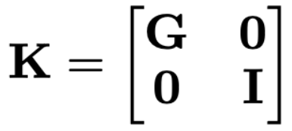
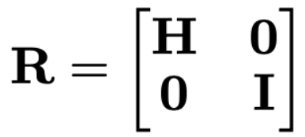
Locking Mechanism – Enhancing Locking Robustness
The key matrix is also a permutation matrix
  To reduce computational overhead, G is partitioned into disjoint groups
  Each group rearrange the elements within the group
The rotation matrix further enhances locking robustness
  H is a random Hadamard matrix whose elements are either -1 or 1
The benefits of R include:
  Evenly distributes the effect of feature outliers across all dimensions
  Enhance interdependence among key bits to obscure their relationships
  Discretize feature values to resist gradient-based attacks
Notes:
The second pair of transformation matrices are the key matrices, K and K-transpose. The K matrix is decomposed into disjoint groups, and each group rearrange the elements within the group.
The third pair of matrices are the rotation matrices, R and R-transpose, which are added to further enhance robustness. The top-left part, H, is a randomized Hadamard matrix, whose elements are randomly sampled from -1 and 1. The benefits of R include: evenly distributing the effect of feature outliers across all dimensions for a more smooth feature distribution, enhancing the correlation between all key bits to obscure their relationships, and discretizing feature values to resist gradient-based attacks.

Slide 10
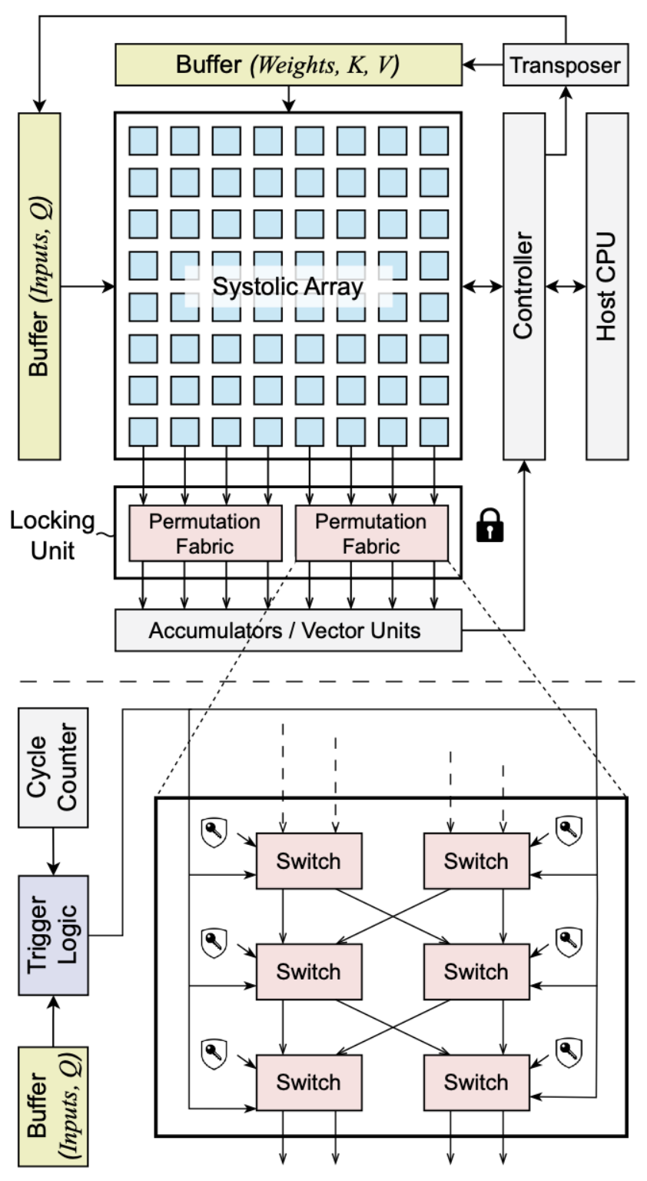
Locking Mechanism – Hardware Arch.
LLA is designed to be compatible with almost any AI compilers or accelerators
The locking unit consists of multiple permutation fabrics
  Implemented with key-controlled butterfly network
  Shuffles several consecutive output lanes
The trigger logic determines when to activate the locking unit
  It introduces a specific delay to each output lane according to the dataflow pattern
Notes:
To support locking operations, LLA adds several lightweight modules to AI accelerator hardware. It is designed to be compatible with almost any dataflow patterns, and is not dependent on any specific AI compilers.
The locking unit consists of multiple permutation fabrics. Each fabric is implemented with a key-controlled butterfly network and it shuffles several consecutive output lanes of the systolic array. The trigger logic determines in which cycle the locking unit should be activated. It introduces a specific delay to each output lane according to the dataflow pattern of the systolic array.

Slide 11
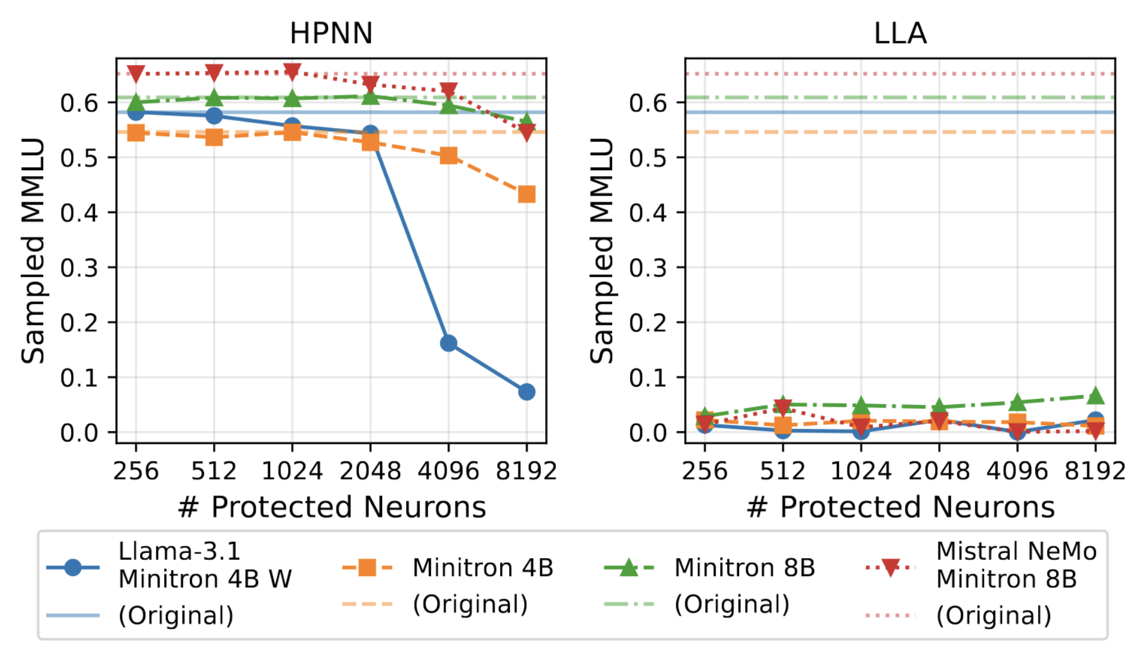
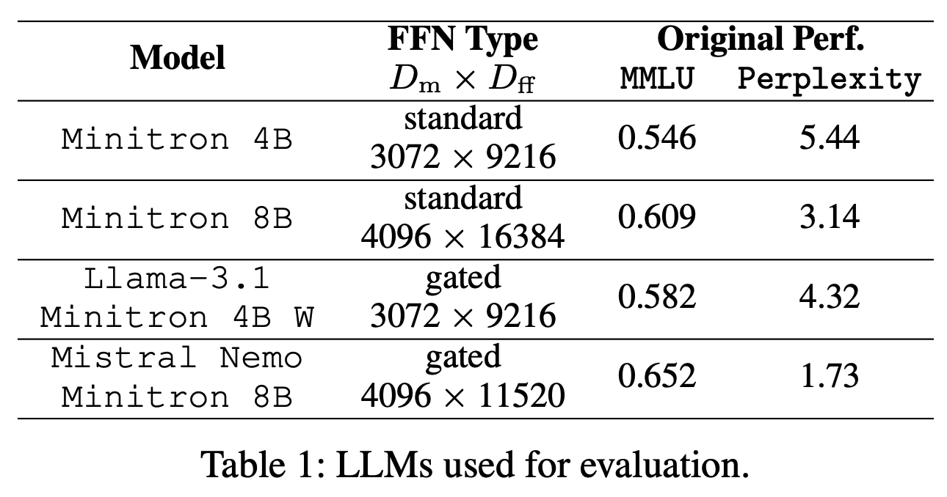
Experimental Setup and Locking Effectiveness
We apply LLA on 4 models in the Minitron family
Pre-attack locking effectiveness:
  HPNN, the current state-of-the-art model locking technique, is ineffective on generative models with billions of parameters
  LLA is highly effective across all configurations
Notes:
We conduct experiments on the Minitron family of large-language models.
The right figure compares the locking effectiveness of LLA against the state-of-the art model locking technique, HPNN. Even without an attack, HPNN is barely effective on large-language models with billions of parameters. In contrast, LLA renders all models unusable with only 256 key bits.

Slide 12
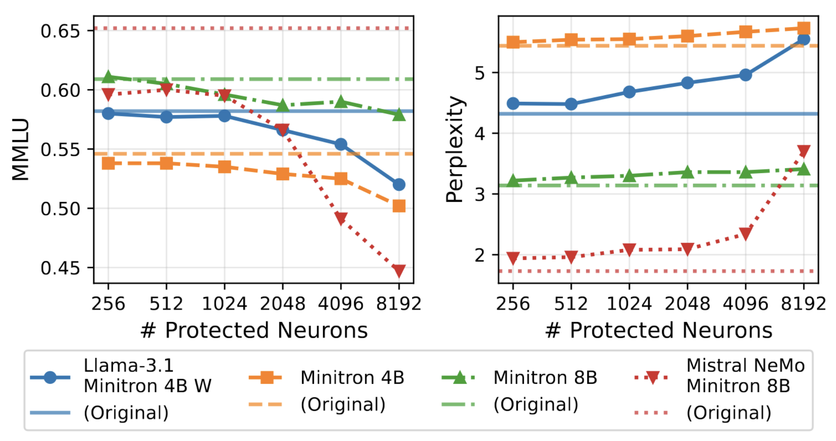
Locking Robustness
Oracle-guided attack: the adversary can query an activated model for polynomial times and observe the outputs
  It then launches a gradient-based or a genetic-based attack to extract key values
Post-attack locking robustness:
  The adversary can recover no more than 38% of performance degradation with 8,192 key bits
Notes:
Oracle-guided attack is the most powerful attacks against model locking. In this setting, the adversary can query an activated model for arbitrary times and collect the corresponding outputs. It then launches a gradient-based attack or genetic-based attack to infer the correct key values. According to our experiments, the adversary can recover no more than 38% performance degradation when there are 8,192 key bits, indicating the high robustness of LLA.

Slide 13
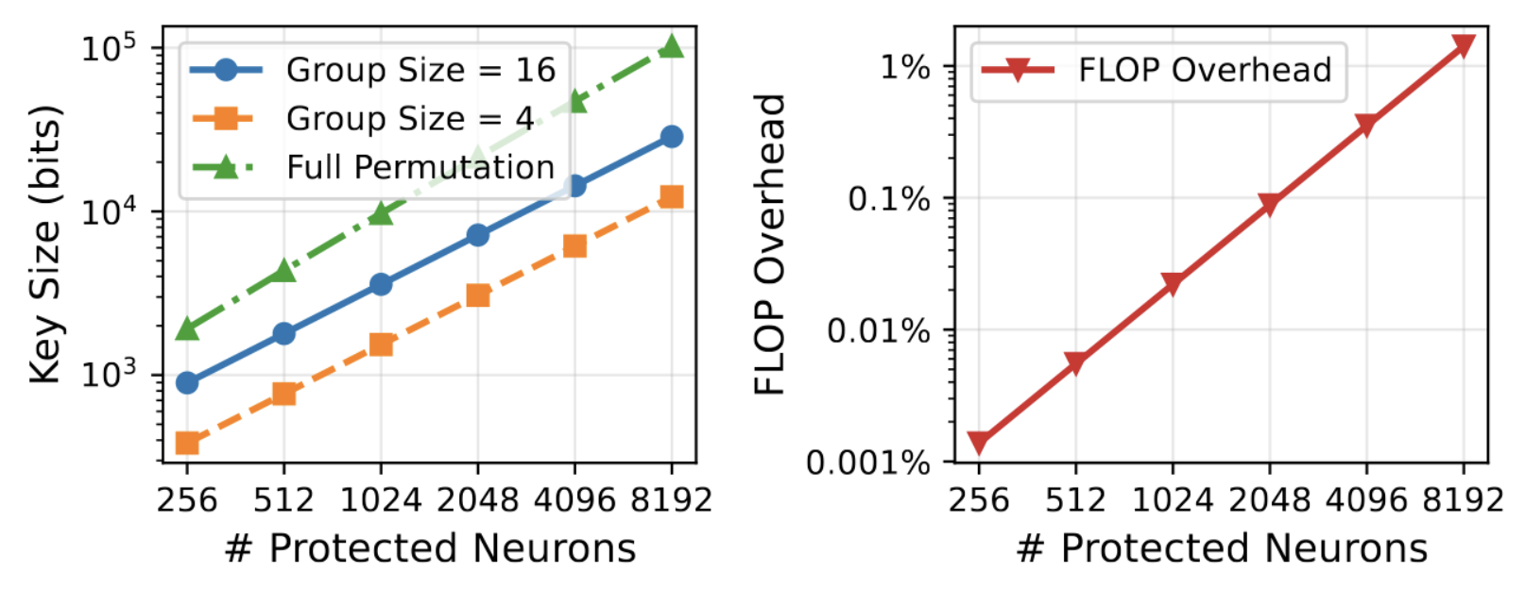
Locking Efficiency
LLA is highly efficient and scalable to large generative models
  The computational overhead is around 0.001% for 256 key bits and 0.1% for 2,048 key bits
  Key size grows linearly with the number of protected neurons
Notes:
LLA is highly efficient. The computational overhead is merely 0.001% for 256 key bits, and 0.1% for 2,048 key bits.

Slide 14
Thank you!
If you have any questions, please contact us at
acl2022@underline.io
We are happy to help!
Notes:
Thank you for your attention!

Slide 15
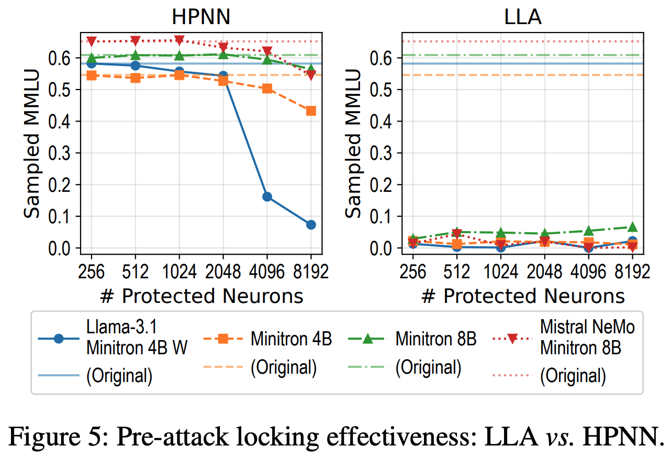
Experimental Results – Setup & Effectiveness
Notes:
Now let’s look at the experimental setup. On the left side, Table 1 shows the models we used. We tested four different models, including Minitron and Llama 3. This ensures our method works for different model sizes and structures.
On the right side, Figure 5 compares the effectiveness of our method with HPNN, a previous state-of-the-art method. Please look at the left plot for HPNN. Most lines stay high, which suggests the protection is limited, except the blue line for Llama 3.1, which drops when we protect more neurons. In contrast, if you look at the right plot for LLA, all lines consistently stay at the bottom. This demonstrates that our method is generally more effective at suppressing model functionality.

Slide 16
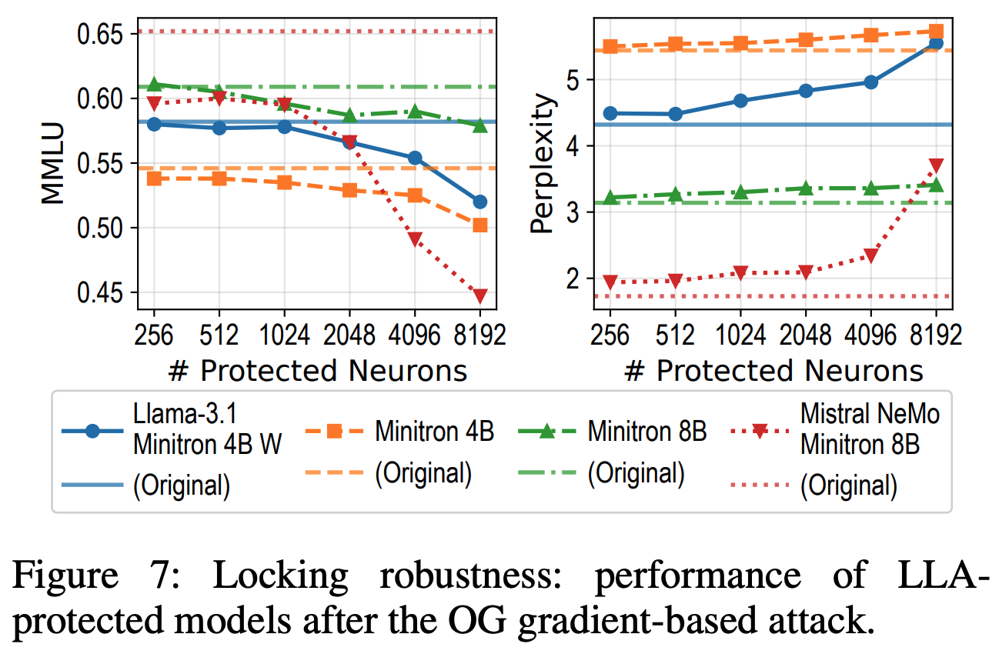
Experimental Results – Locking Robustness
Notes:
Next, I will talk about robustness. We tested LLA against a very strong attack called the OG Gradient Based Attack. Here, OG stands for “Oracle Guided”, where the attacker tries to guess the key using outputs from an oracle model.
Please look at Figure 7. The x-axis represents the number of protected neurons. As we move to the right, we use a larger key size. You can see that the MMLU scores on the left decrease, and the Perplexity on the right increases. Although the model might still run, its performance is degraded compared to the original level. This suggests that the attack reduces the quality of the model, making a pirated version less competitive.

Slide 17
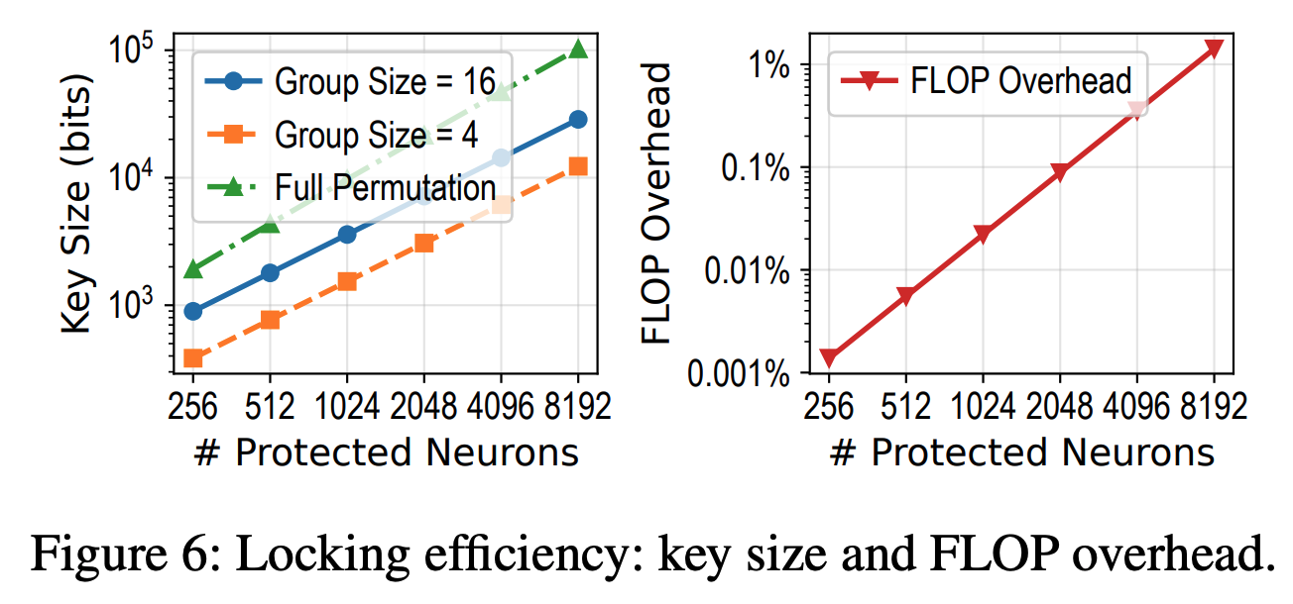
Experimental Results – Locking Efficiency
Notes:
Now let us discuss efficiency. We aim for a balance between security and cost.
Figure 6 shows the overhead. The red line on the right graph indicates that the computational cost is very small.
The graph on the left shows that the key size grows linearly. This indicates that we can scale up the protection to a high security level with a manageable cost.

Slide 18
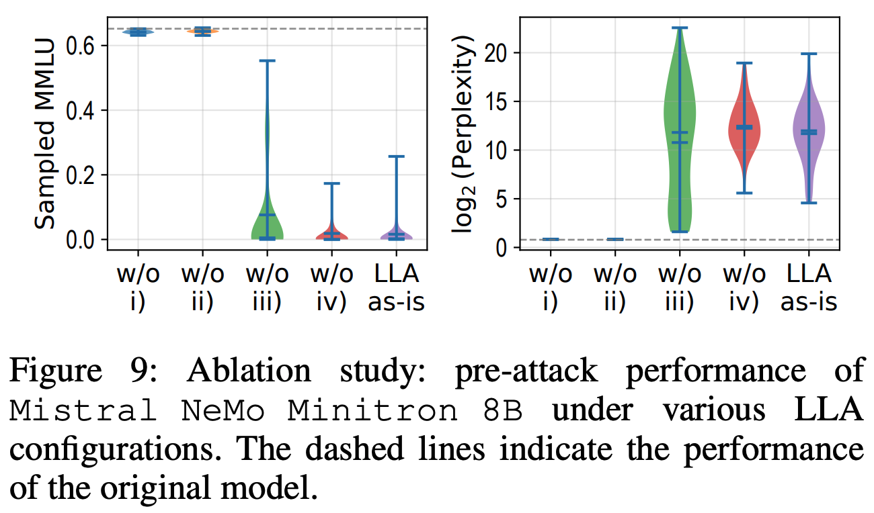
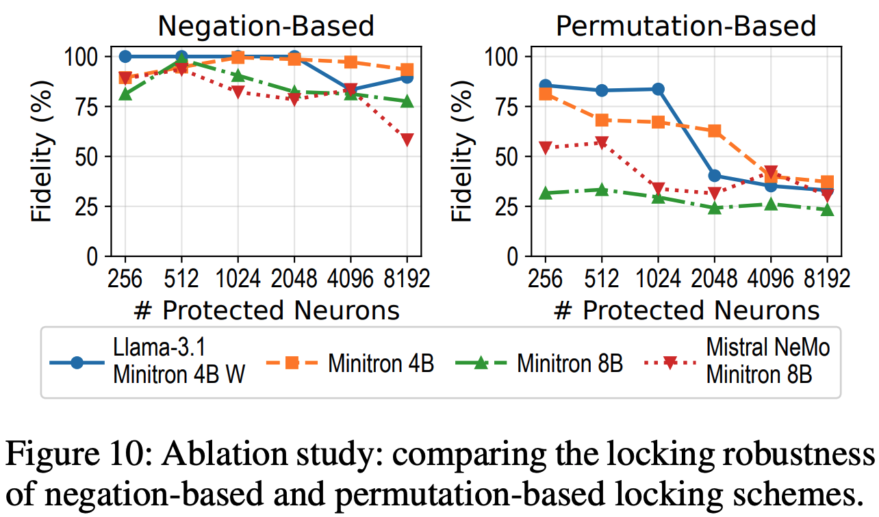
Experimental Results – Ablation Study
Notes:
Finally, we conducted an ablation study to analyze our design.
On the left, Figure 9 shows different configurations. Columns 1 and 2 show that without selecting the right blocks or outliers, the lock is not effective. Column 3 shows the result without the Rotation Matrix. The performance varies a lot, meaning the protection is not stable without it.
The last two columns compare Negation and Permutation methods. We compare them further in Figure 10 on the right. The 'Negation Based' plot shows high fidelity, meaning the attack is often successful. However, our 'Permutation Based' method maintains much lower fidelity. This suggests that shuffling the values provides better security than just flipping them.

