Slide 1

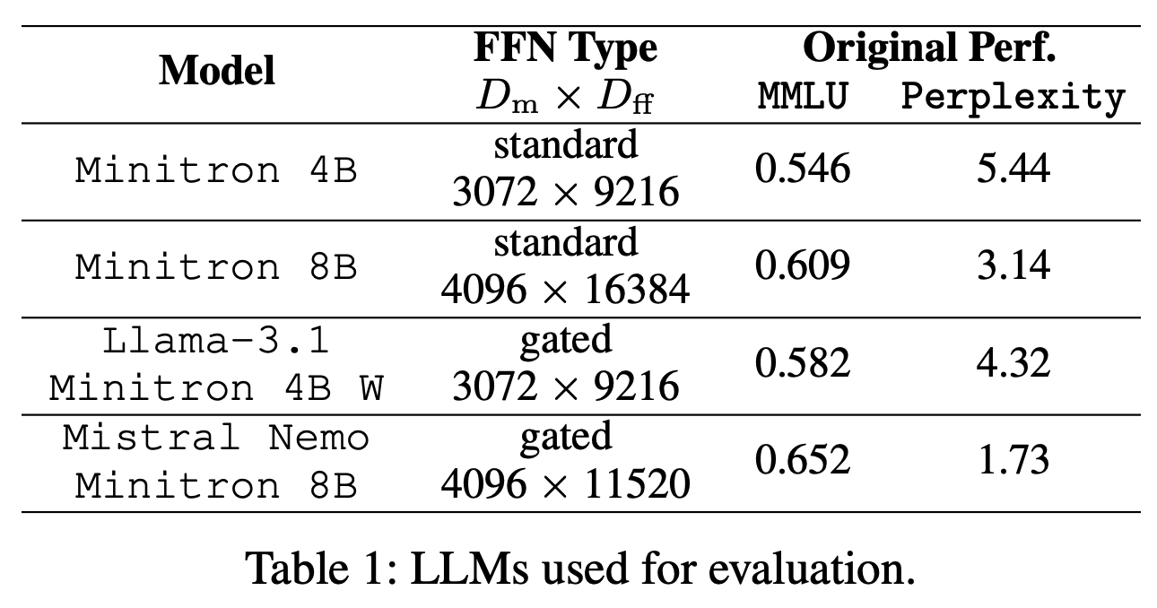
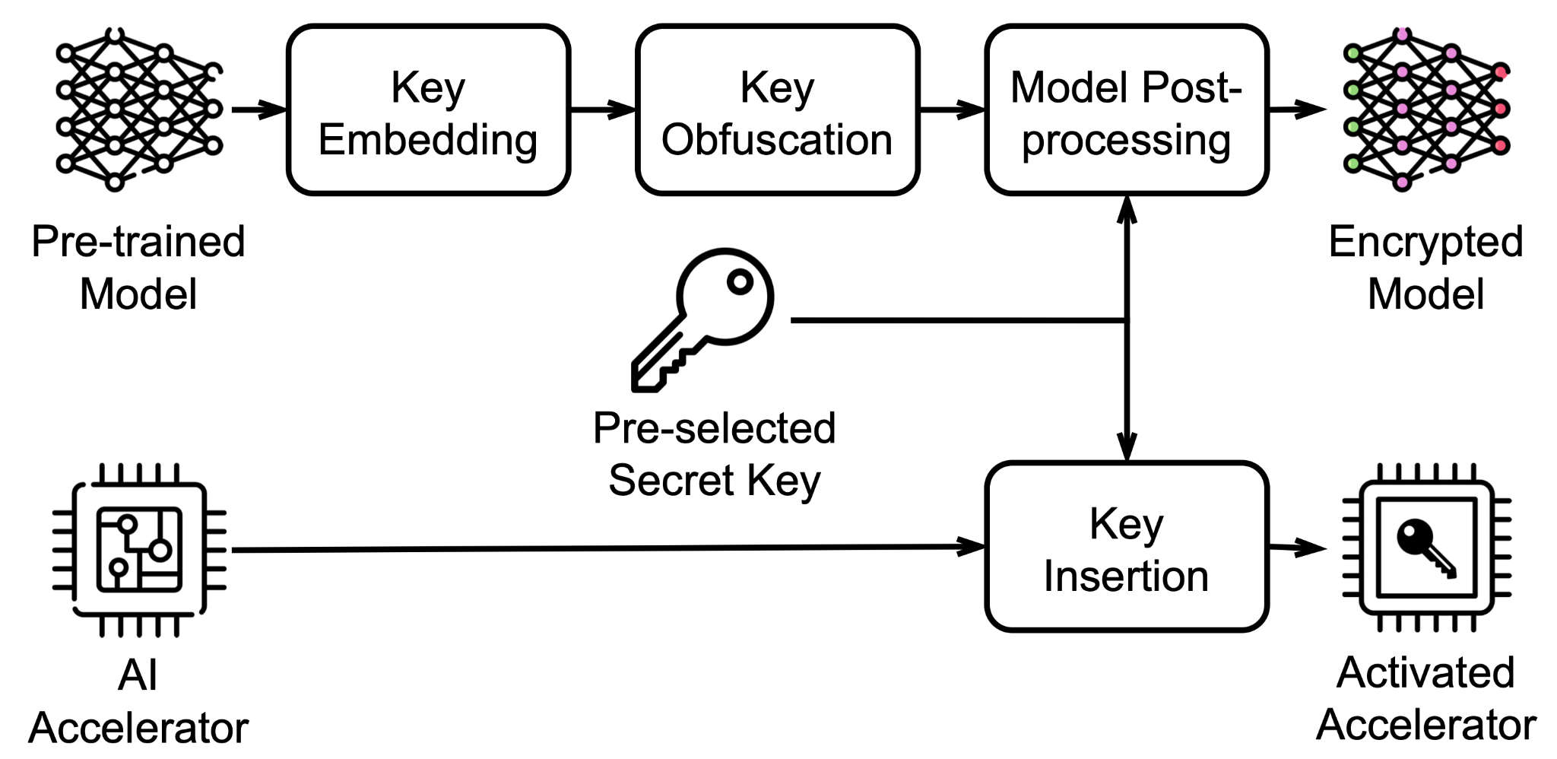
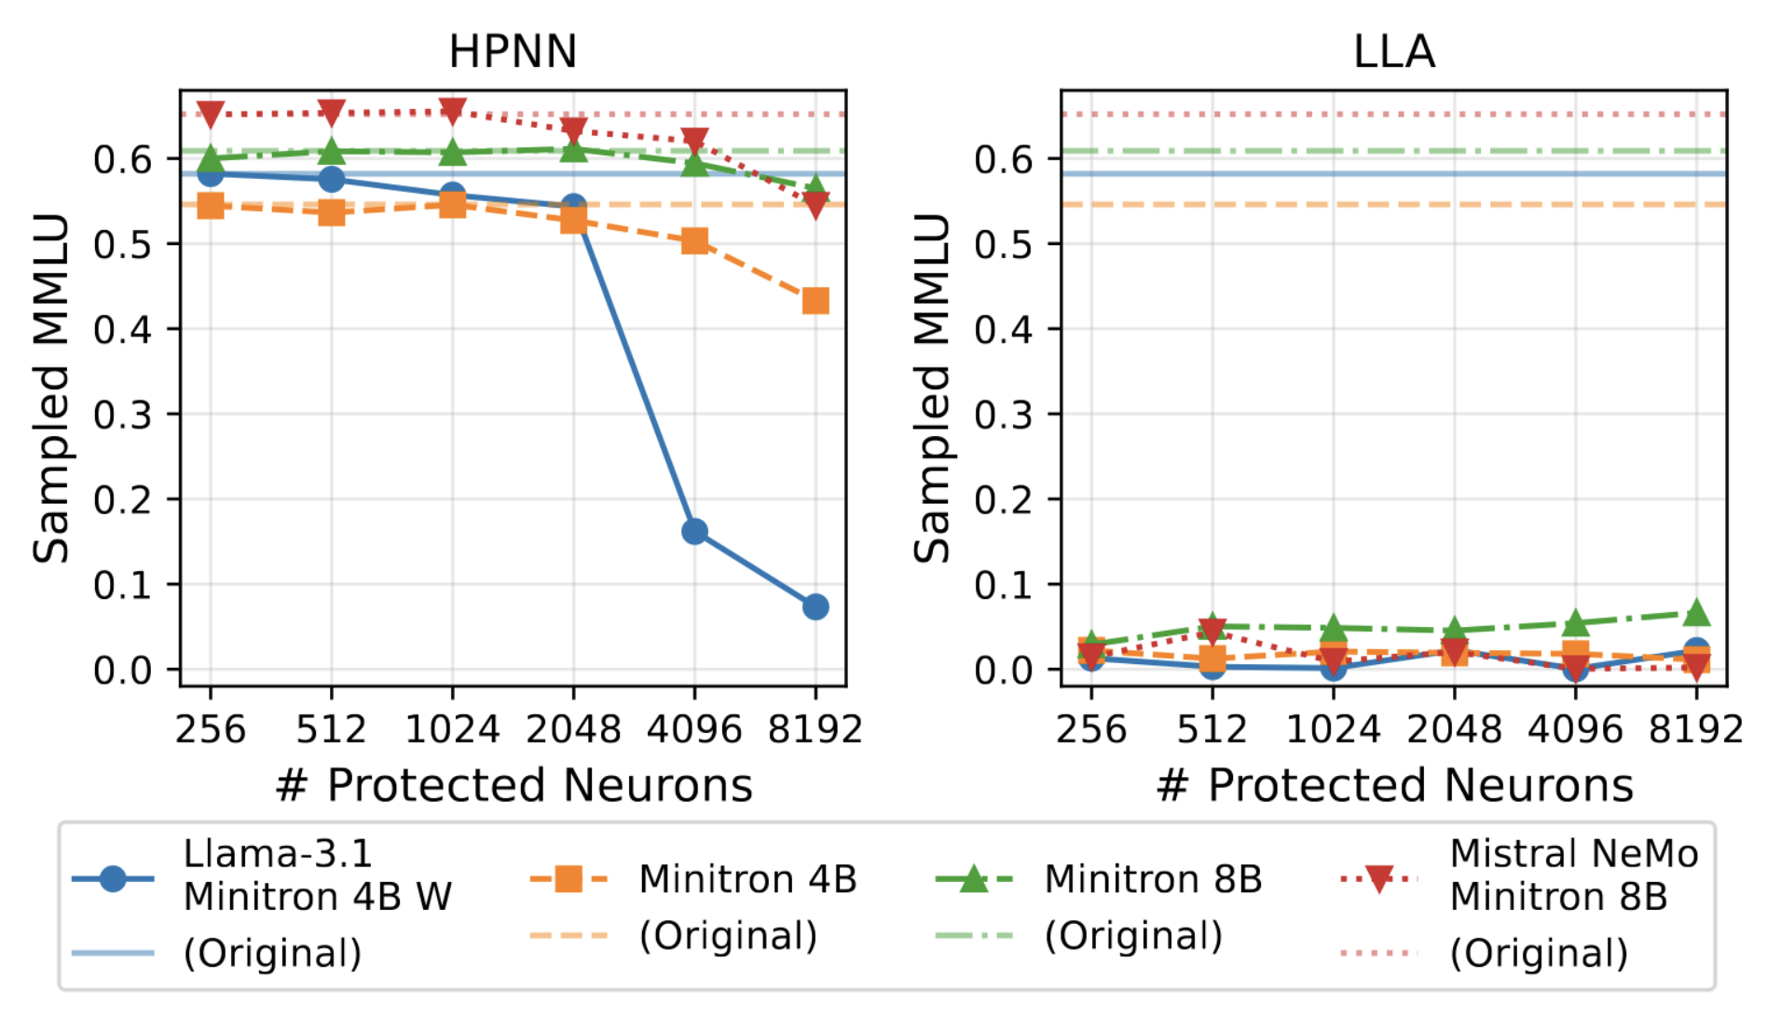
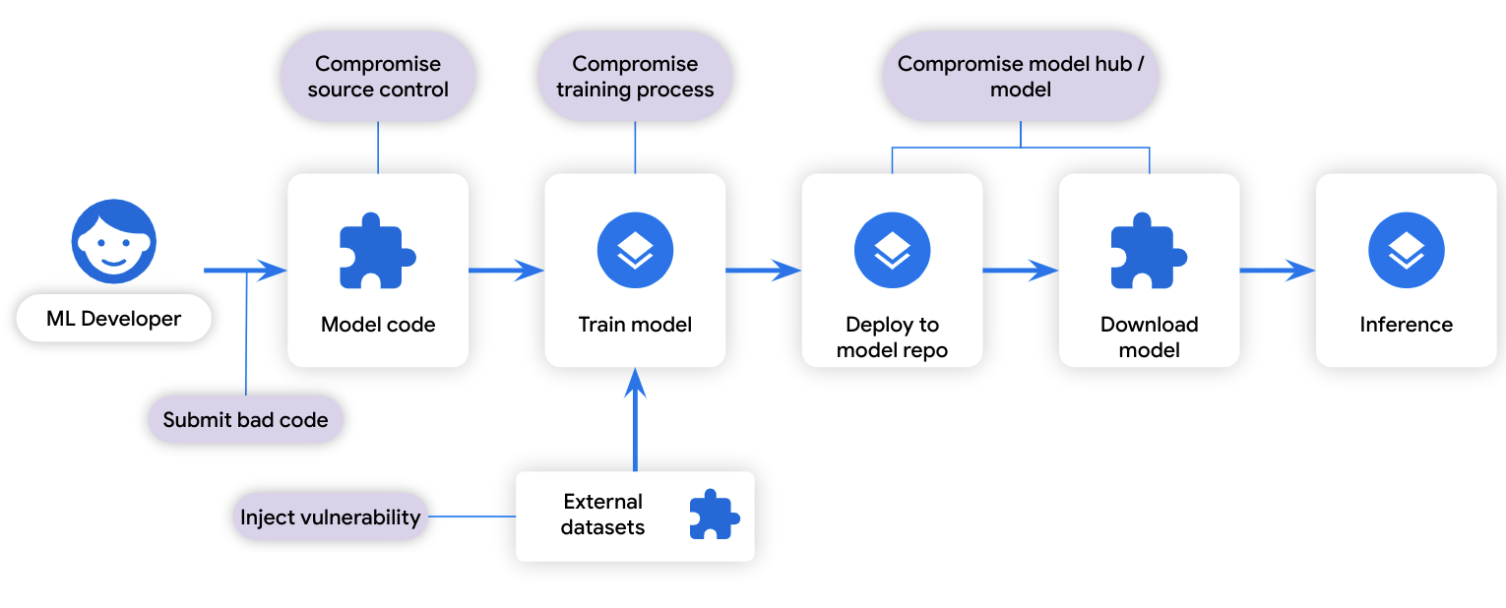

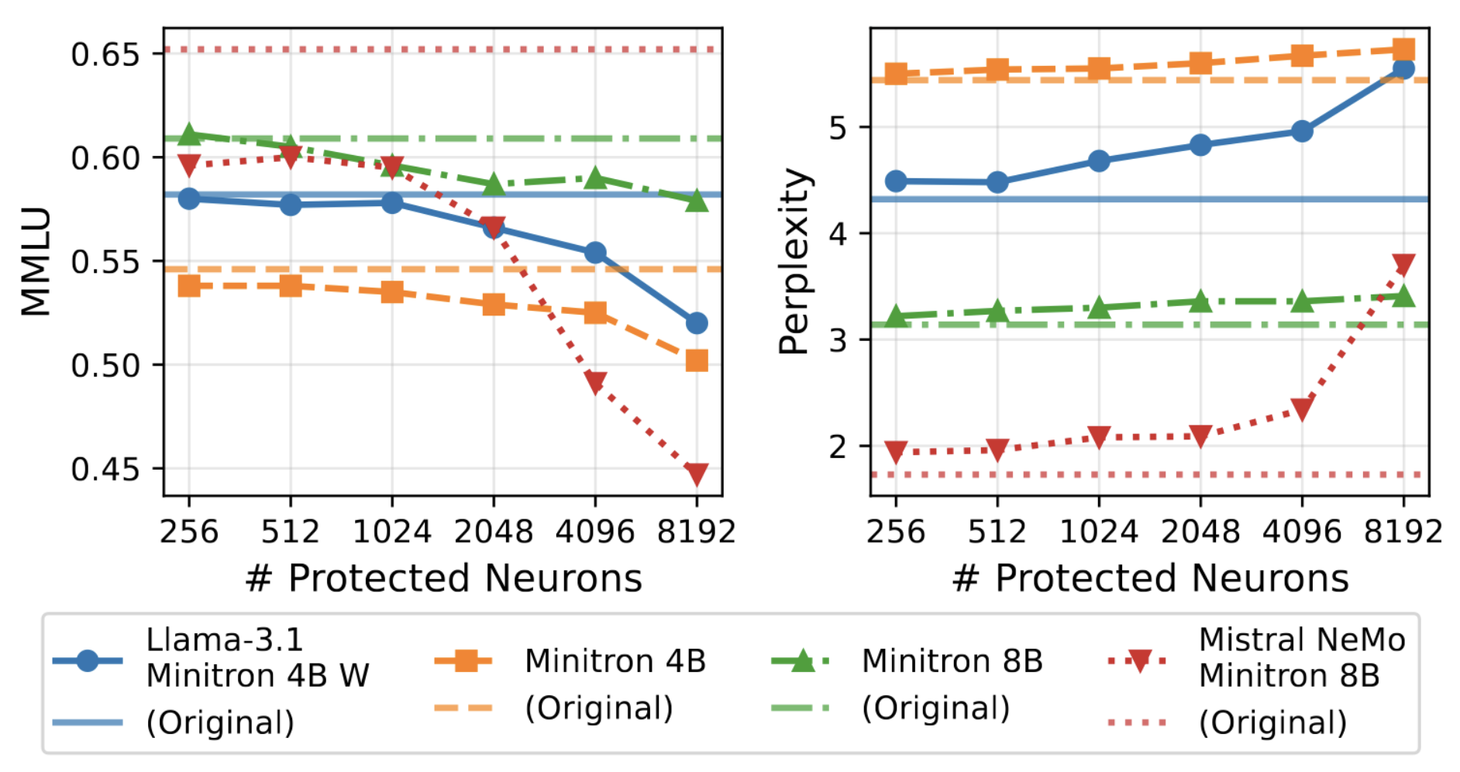
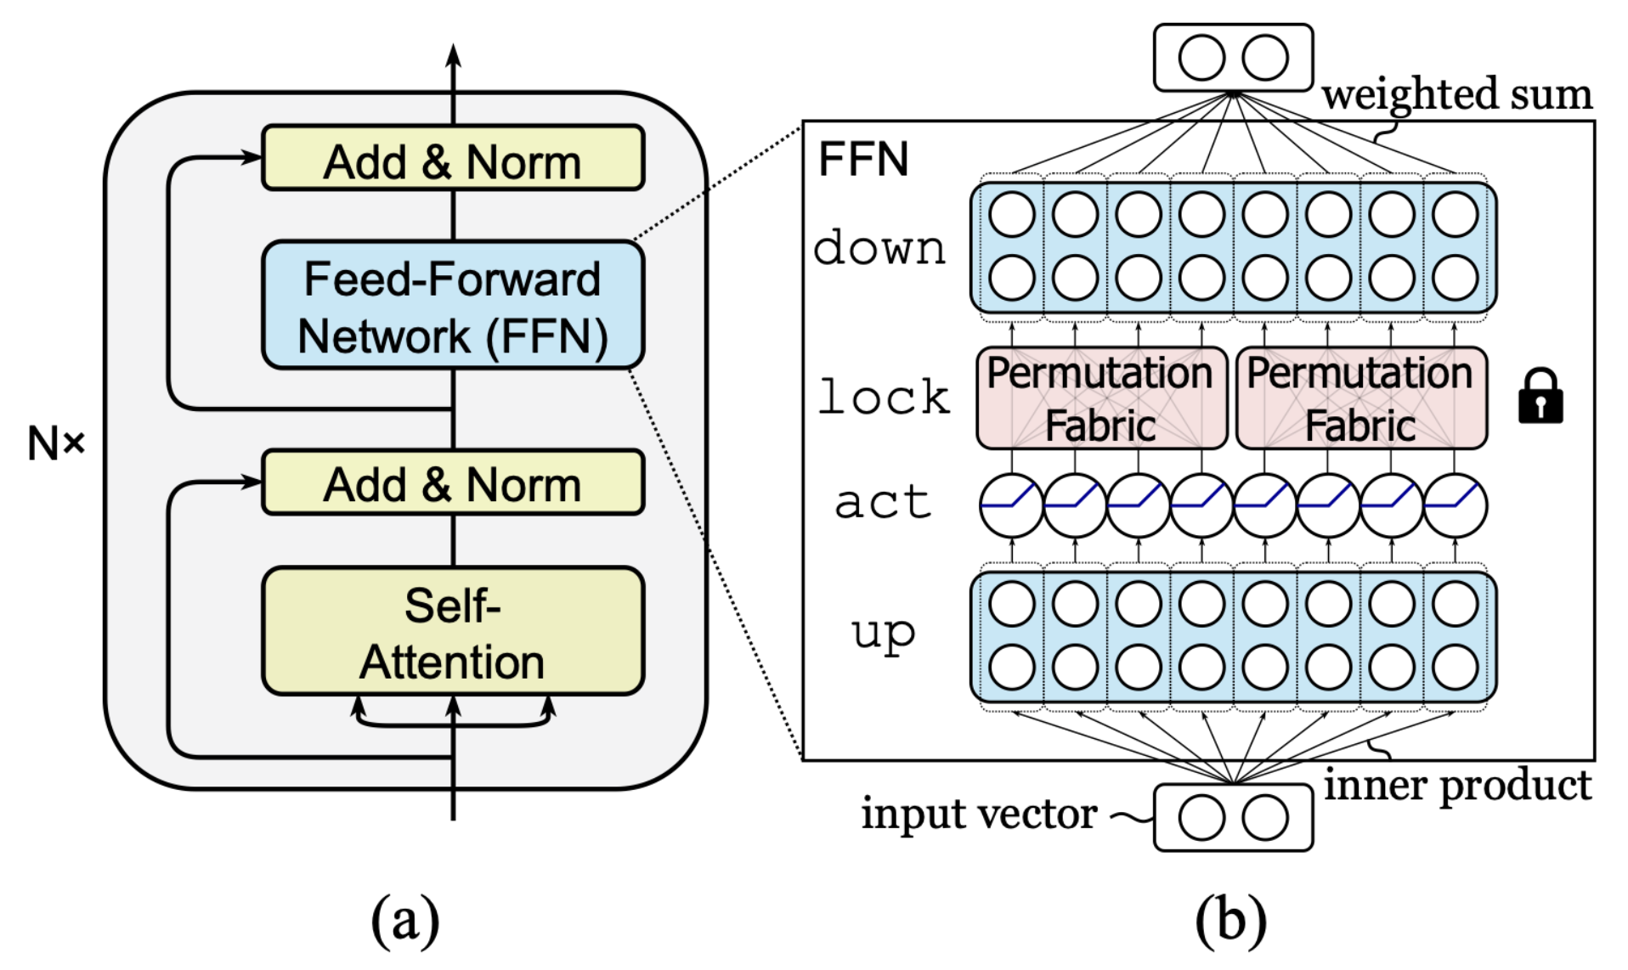
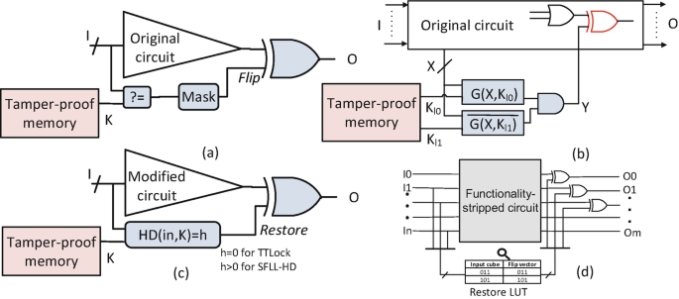
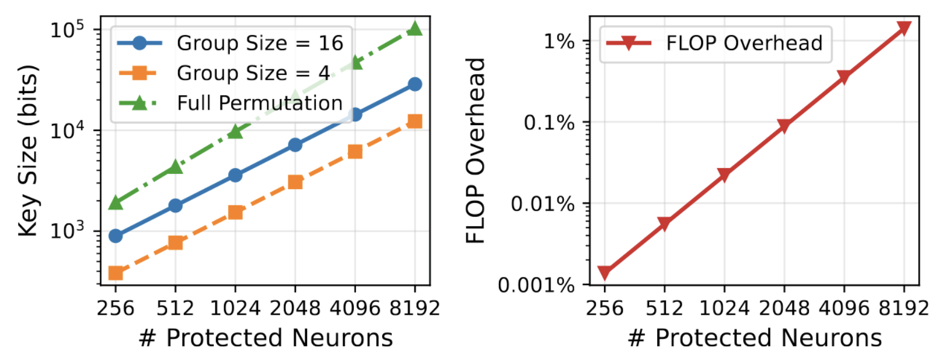
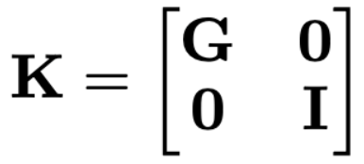
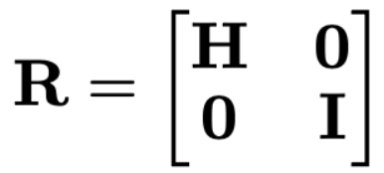
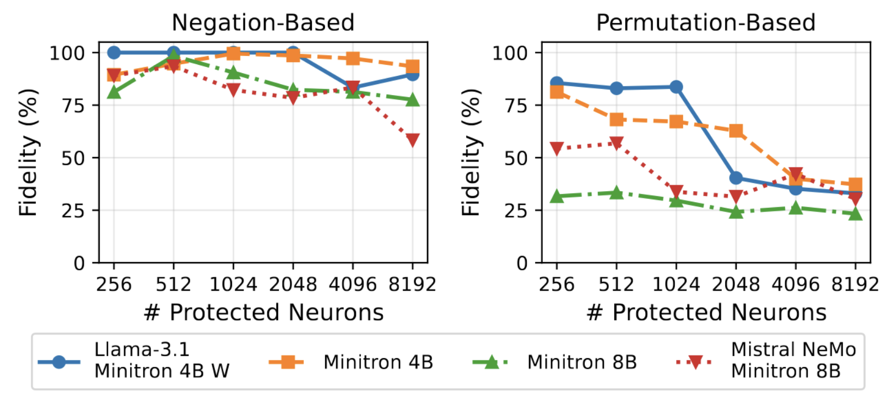
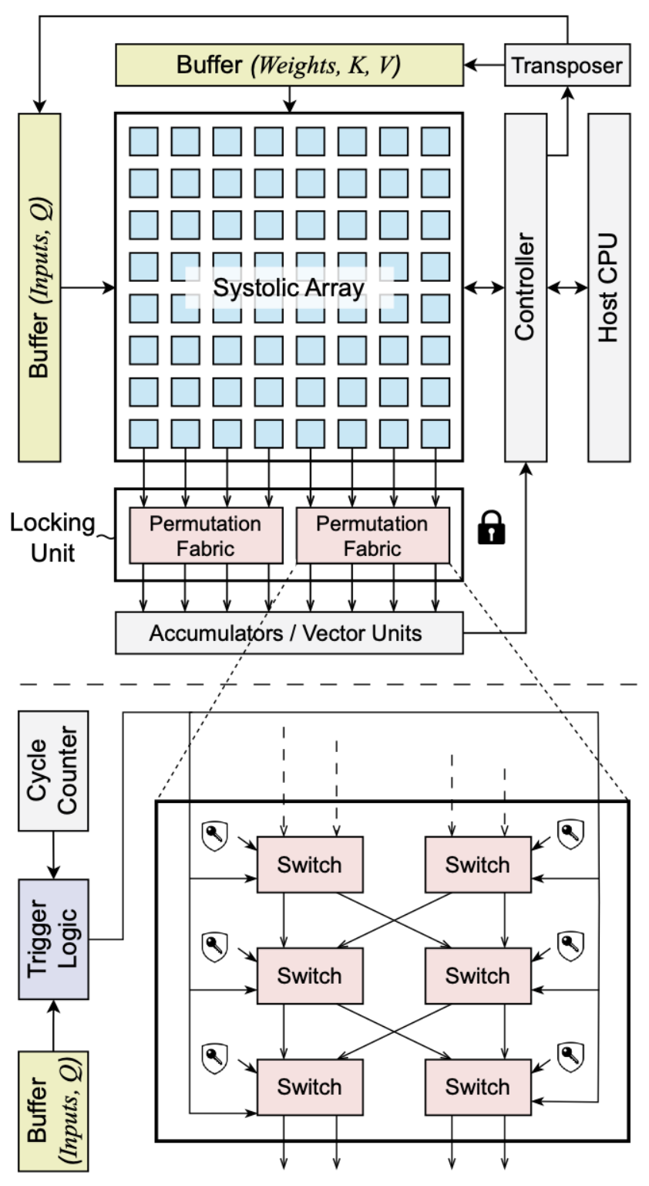
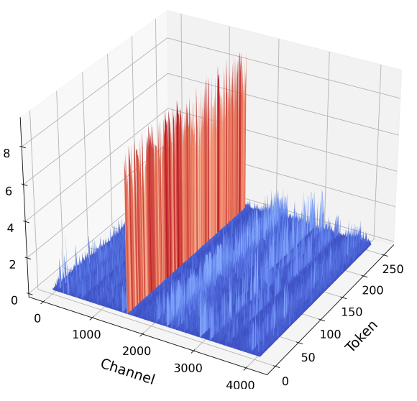

LLA: Enhancing Security and Privacy for
Generative Models with Logic-Locked Accelerators
You Li*, Guannan Zhao*, Yuhao Ju, Yunqi He, Jie Gu and Hai Zhou
Supply Chain Security of GenAI Models
Overall Workflow
Evaluations
GenAI is a revolutionary technology, but model training requires massive data, substantial resources and high expertise
New business models for GenAI:
Inference-as-a-service: models are hosted on the cloud and accessed through APIs
Self-hosting: models are deployed within an organization
In both scenarios, model parameters are directly exposed to various participants within the supply chain, including cloud service providers, network service providers, or end-users.
Unauthorized use or distribution of proprietary models can cause financial loss to the intellectual property owners.
Unrestricted access to model parameters can pose serious security risks:
Adversarial prompts: generating harmful or misleading contents
Backdoor attacks: manipulating generated outputs through malicious triggers
LLA is an inference time model locking framework
It leverages the synergy of software and hardware to achieve both robustness and efficiency
We evaluated LLA on the Minitron family of models with different model architectures
Pre-attack locking effectiveness:
HPNN, the current state-of-the-art model locking technique, is ineffective on large generative models
LLA renders models unusable across all configurations
A model functions correctly only when the correct key is embedded in hardware
An encrypted model can be sent to the user through a public channel
An accelerator with pre-installed secret key serves as a licence to access the service of the model IP owner
Locking Mechanism
Oracle-guided attack:
The adversary can query an activated model for arbitrary times and observe the corresponding outputs
It then launches a gradient-based or genetic-based attack to infer key values
Post-attack locking robustness:
The adversary can recover no more than 83% performance degradation for 256 key bits, and 38% for 8,192 key bits
The locking procedure is a sequence of function-preserving orthogonal transformations ( ):
Every transformation matrix is canceled by its transpose
All matrices within parentheses are merged with W^{up} and W^{down}
LLA selects the feed-forward network (FFN) of a single transformer layer to place key bits:
Weight outliers concentrate in W^{down}
Ensure that all key bits are correlated
From Logic Locking to Model Locking
Logic locking leverage hardware root-of-trust to protect the supply chain of integrated circuits
Embeds protection units into the circuit netlist
Each unit is controlled by binary key bits
The secret key is stored on-chip in a tamper-proof module
An adversary cannot recover the original functionality of the circuit without knowing the correct key
Locking efficiency:
Key size grows linearly with the number of protected neurons
Computational overhead is 0.001% for 256 key bits, and 0.1% for 2,048 key bits
The permutation matrix P swaps neurons, so that all protection neurons are repositioned to the front of the feature dimension
Neurons that can trigger weight outliers in W^{down} are selected as protected neurons.
In practice, we use random simulation to detect such neurons that can produce large feature magnitudes
The key matrix is also a permutation matrix
Decomposed into disjoint groups
Each group rearrange the elements within the group
The rotation matrix is added for obfuscation
H is a random Hadamard matrix, whose elements are -1 or 1
The benefits of R include:
Evenly distribute the effect of feature outlier to all dimensions
Enhance interdependence of key bits to obscure their relations
Discretize feature values to resist gradient-based attacks
Model locking extends logic locking to protect AI models
A network of neurons vs. a network of logic gates
Threat Model
The adversary aims to find the correct key or recover the functionality of the original model.
The adversary is able to:
Access the model architecture and all the parameters
Query the model for polynomial times
Obtain a small portion of the training data (~5%)
Ablation study:
Permutation-based locking is superior than conventional negation-based locking on large generative models
Main Challenges
Hardware Architecture
The gap between software and hardware:
Model locking is a software concept, whereas the secret key is stored on hardware
The redundancy of model parameters:
Most neurons are inactive during inference
Changing parameter values at random have minimal impact on model performance
The existence of outliers (abnormally large weights and features):
Outliers are disproportionately important to performance
An adversary can flip every key bits and observe their effects on outlier features
LLA is designed to be agnostic to almost any AI compiler and AI hardware
The locking unit consists of several permutation fabrics
Each fabric shuffles several consecutive output lanes
Implemented with key-controlled butterfly (Benes) network
The trigger unit determines when to activate the locking unit
It introduces a specific delay to each output lane according to the dataflow pattern of the systolic array
Conclusion
We propose LLA, a hardware-software co-design framework that secures GenAI models by locking outlier-critical neurons
LLA utilizes permutation and rotation-based transformations to effectively thwart advanced oracle-guided key optimization attacks
The lightweight locking module is compatible with standard systolic array accelerators and requires no model retraining
Our approach achieves high robustness with minimal impact on inference latency and hardware area
*Equal Contribution

